Slide 1

Market Research Report for Skin Cancer Treatment APP
Philip Mortimer
Geunyeong Kim
Haokun Sun
Zhiyuan Pang
Boyun Liu

Slide 2
Meeting objectives
Other APP
Requirements
Contract
Demonstrate some apps and tell the client our thoughts based on last year’s product
After the demonstration of some apps on the market, hope to get some requirements from client
Hopefully we can sign the contract that reach client’s agreement

Slide 3
APP We Found
01
03
Skin Vision
Scannoma-mole check
02
Skin.AI
Miiskin
04
Has 945 ratings, 4.5 out of 5
Has 178 ratings, 4.5 out of 5
AI-powered app
Has 591 ratings, 4.4 out of 5

Slide 4
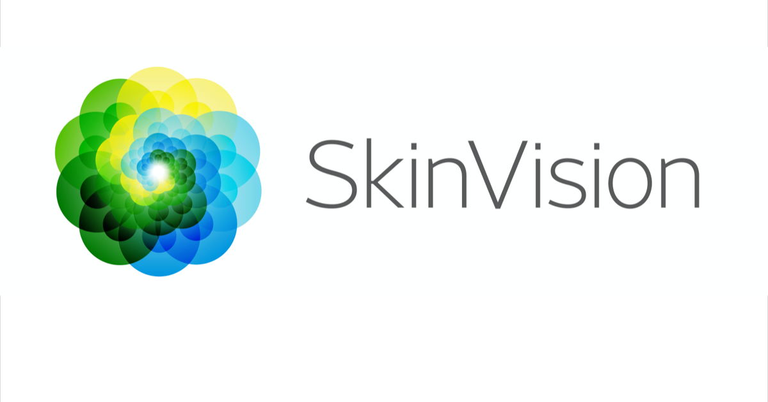
1.Skin vision
Get users’ real time UV index by accessing their current locations and then return users’ some advice.
Ask users to complete a questionnaire about skin type to analyze the sensitivity of skin exposure to sun.
Ask users to complete an easy Yes or No questionnaire called Risk profile to estimate whether the user’s skin is under a high risk or not.
UI and system are very similar to last year's group app.

Slide 5
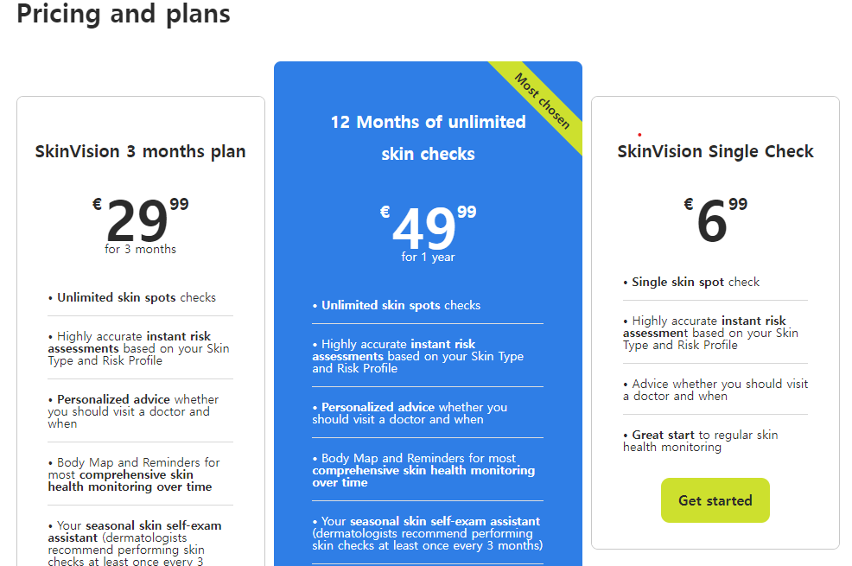
1.Skin vision

Slide 6
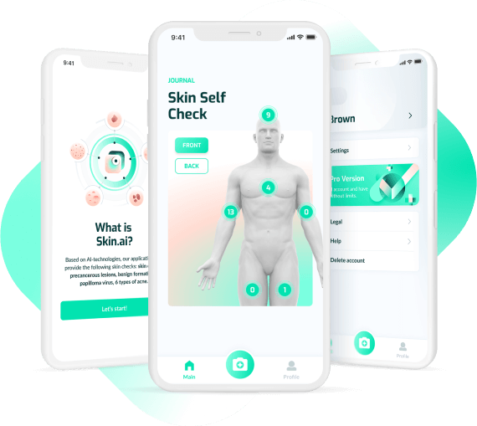
2.Skin.AI
a) Get an instant result(risk assessment, probable diagnosis,…) when users submit their images based on its databases
b) Has a loop to track statistics including numbers of photos uploaded, scheduled visit to a doctor and immediate consultation

Slide 7

3.scanoma-mole check
Provide numbers of new cases for users
Introduce types of skin cancer with pictures for users to do a self-diagnostic
Organize the submitted photos and keep them as a history.

Slide 8
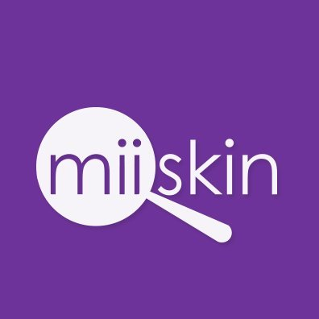
4.Miiskin
Provide users with a reminder to change their time of taking photos of moles and skincare dates
Allow users to export their photos and directly email to the doctor

Slide 9
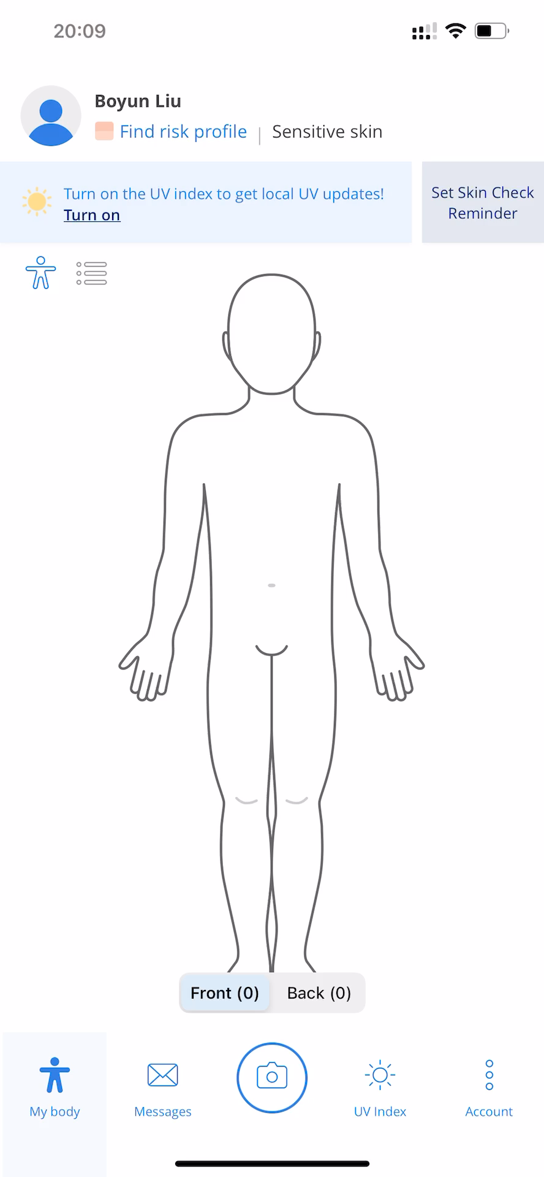
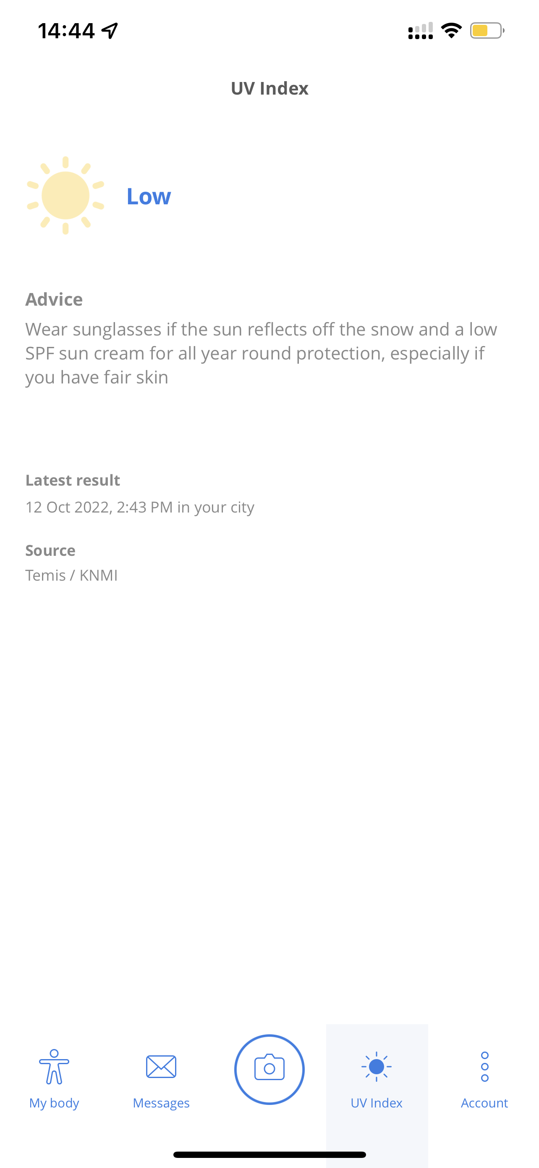
SkinVision
return

Slide 10
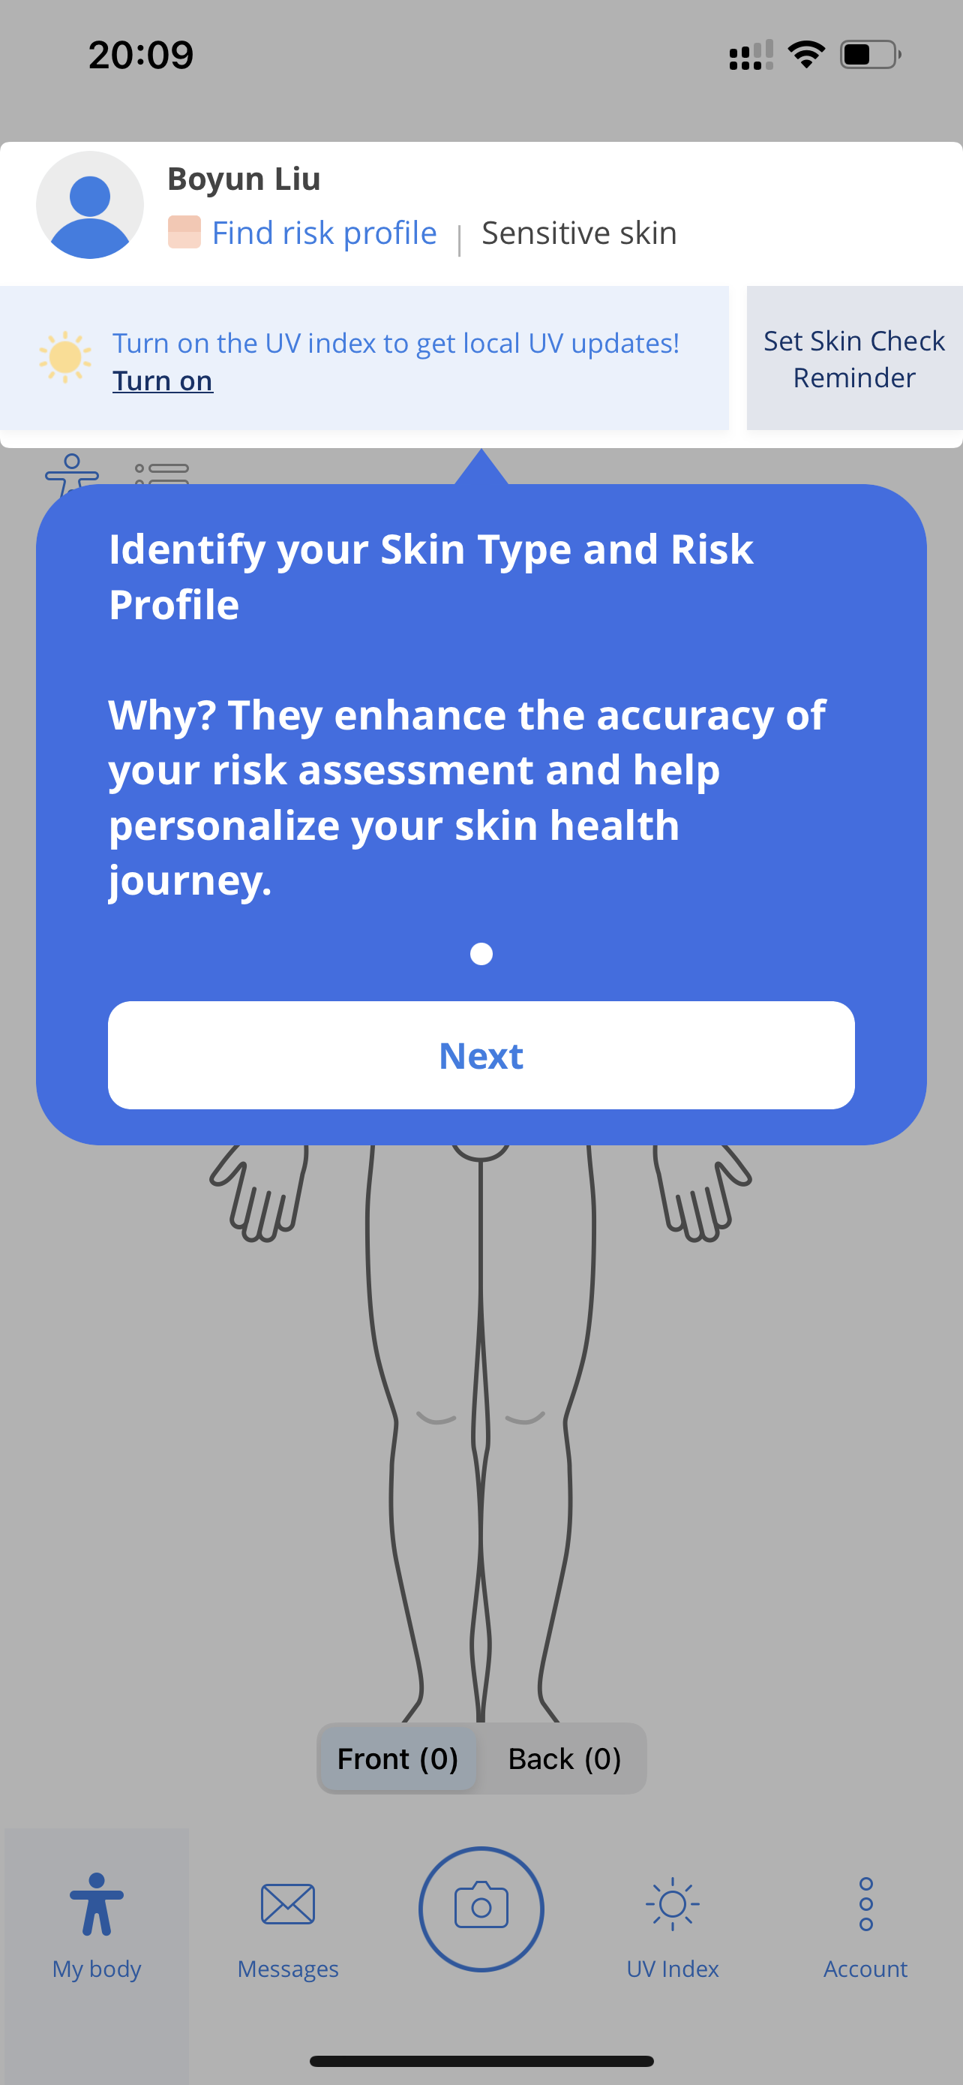
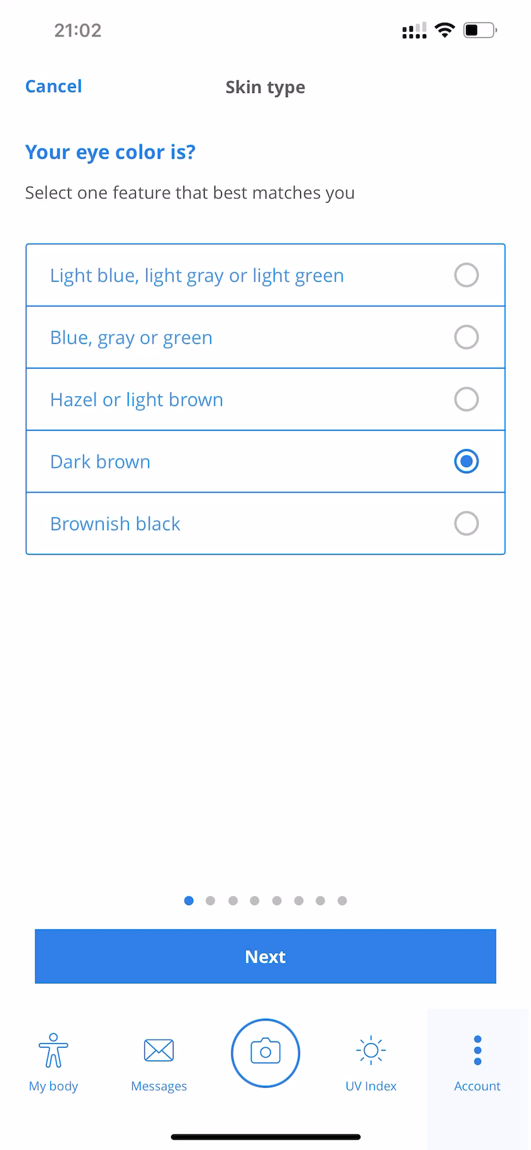
SkinVision
return

Slide 11

SkinVision
return

Slide 12
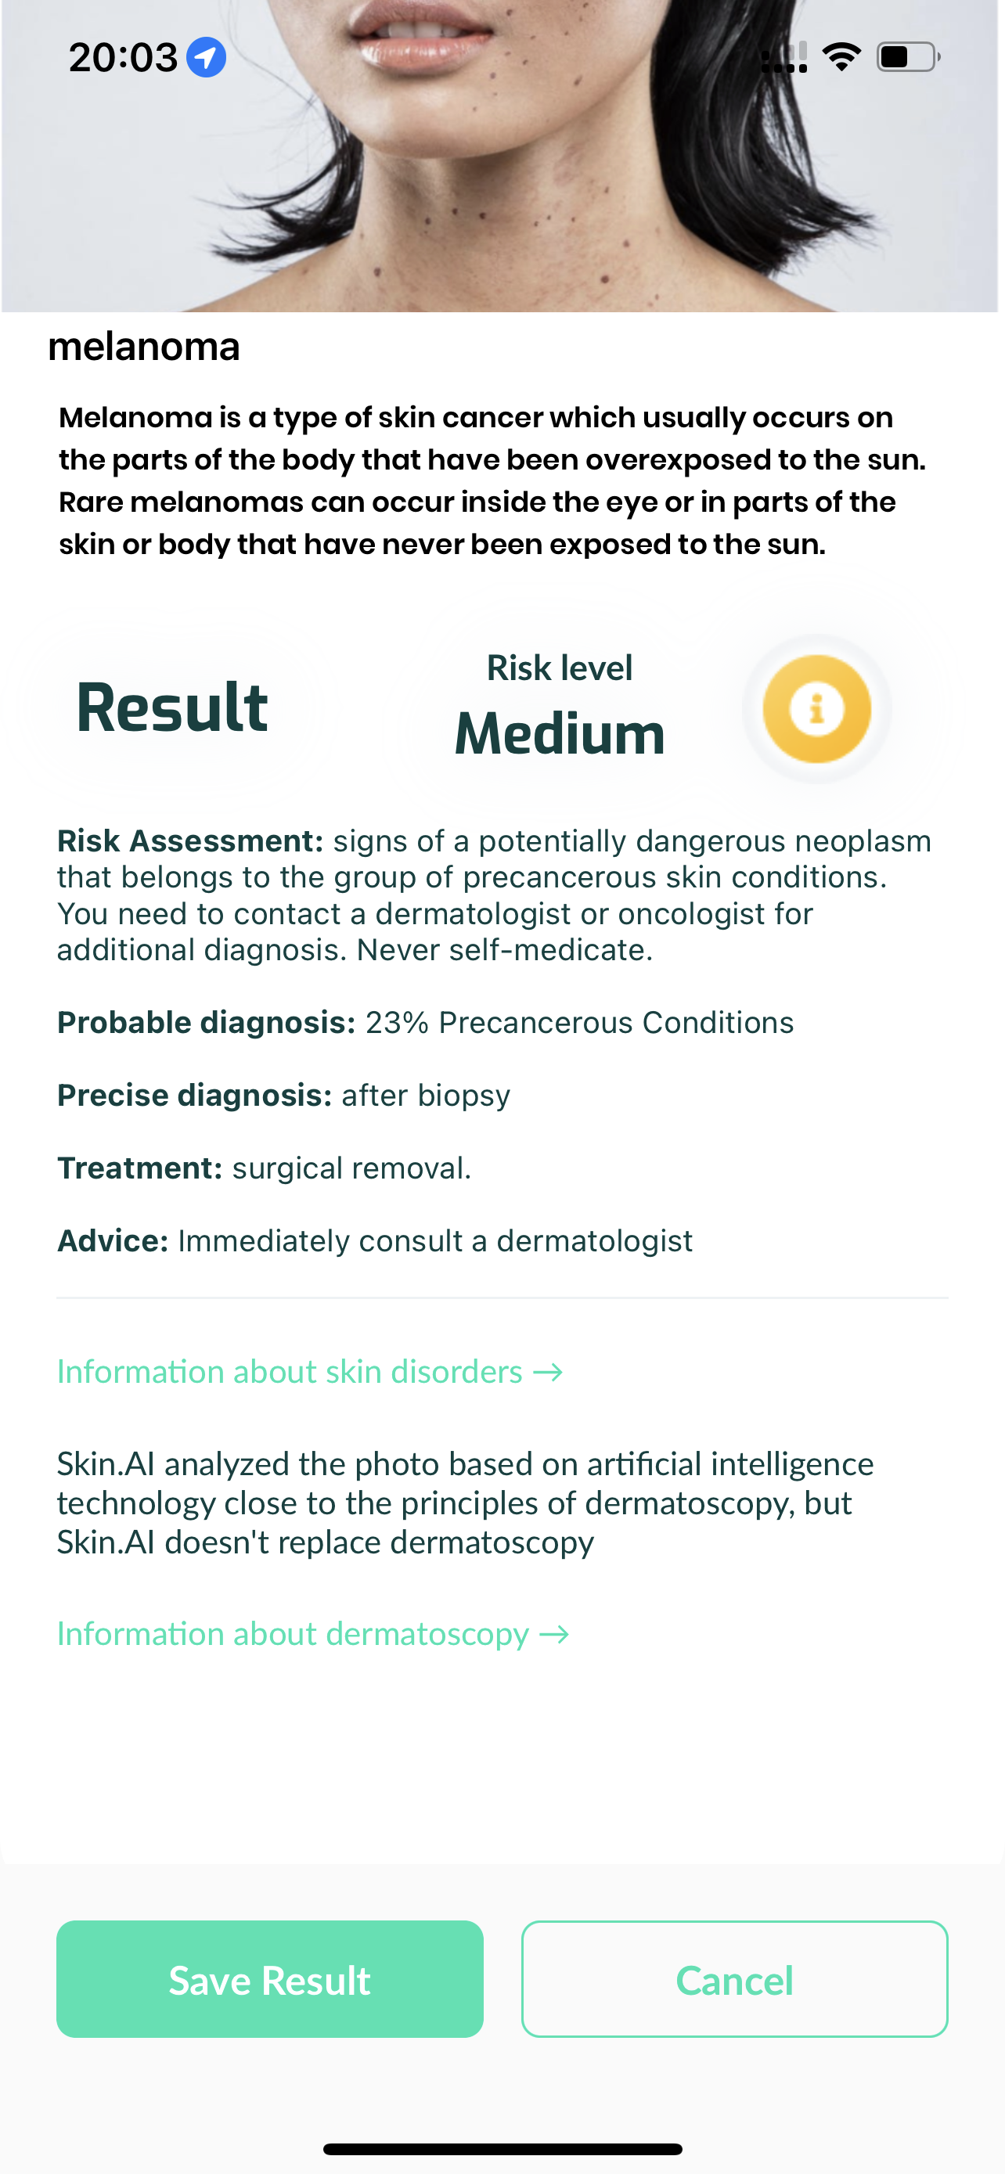
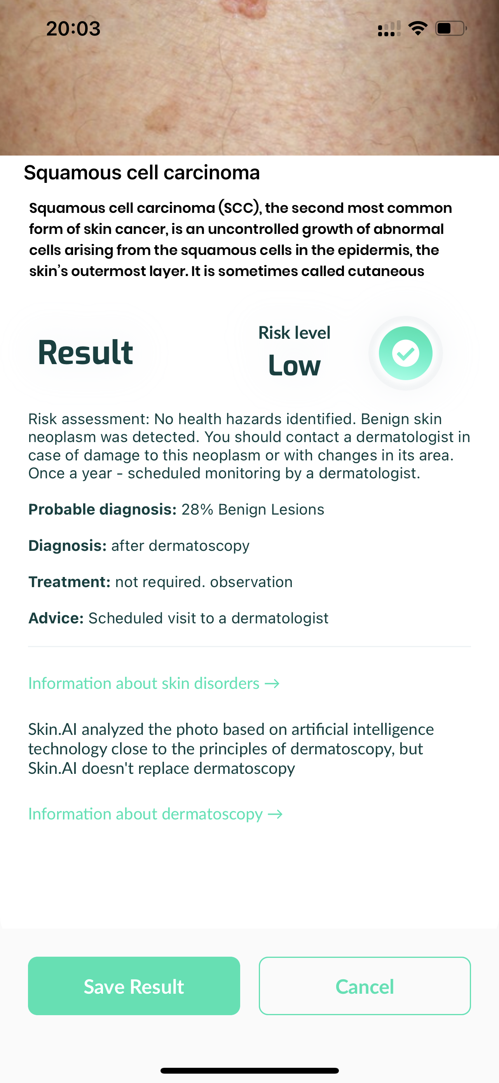
Skin.AI
return

Slide 13
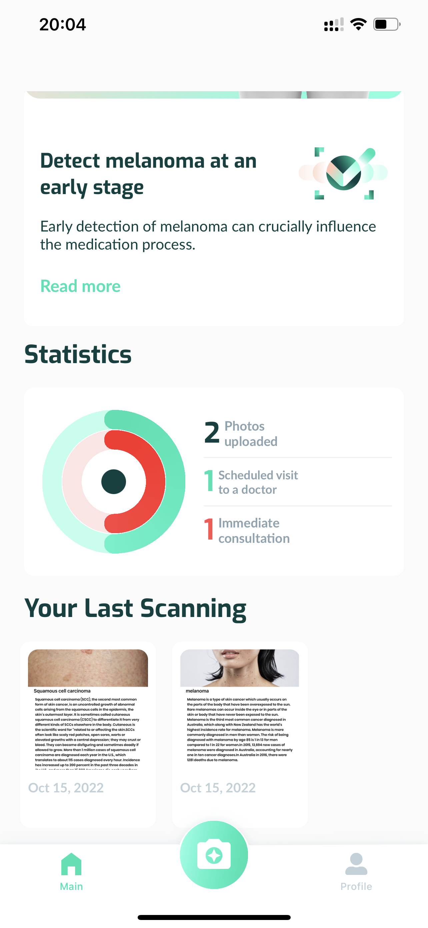
Skin.AI
return

Slide 14
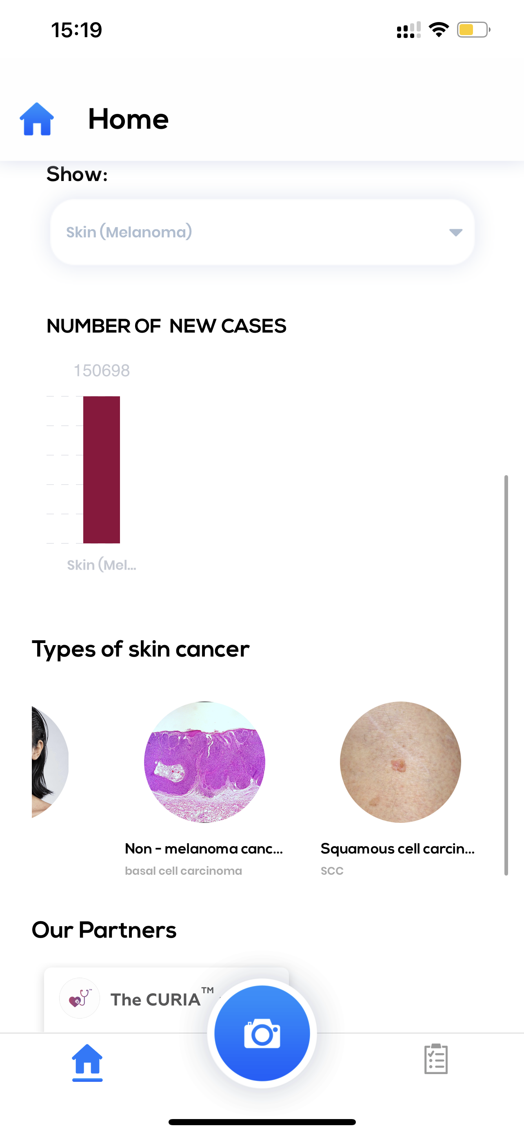
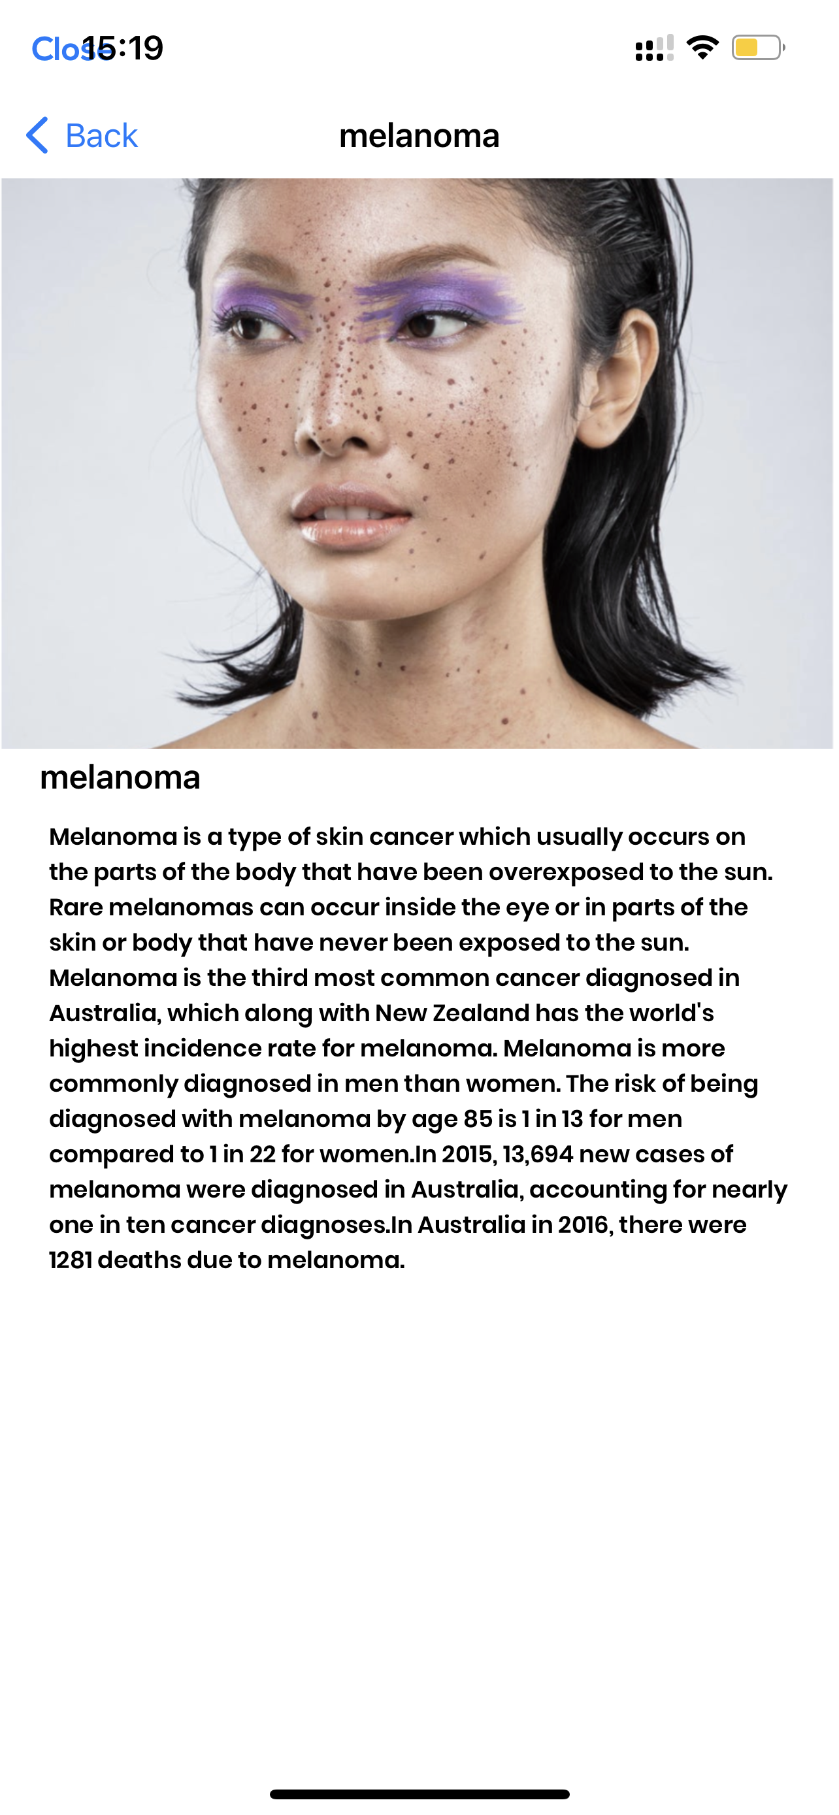
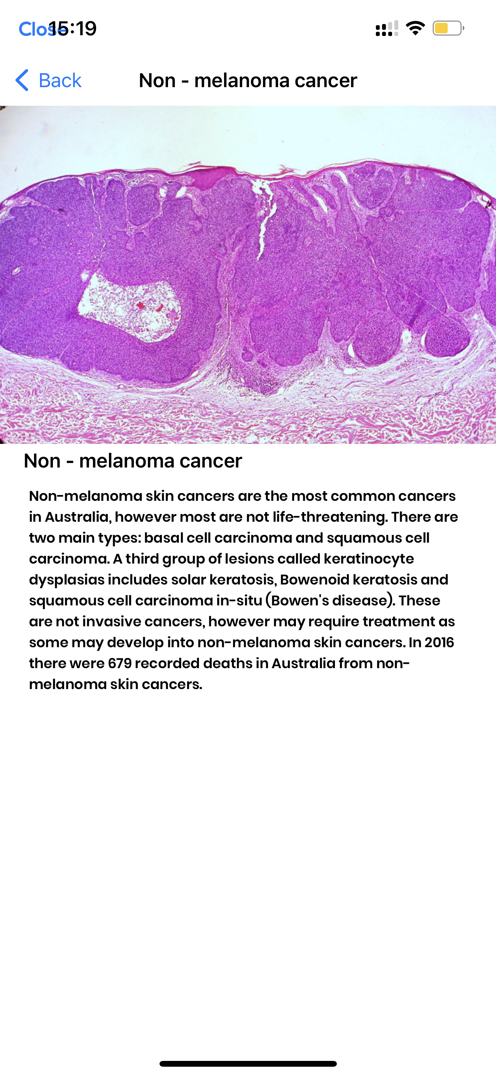
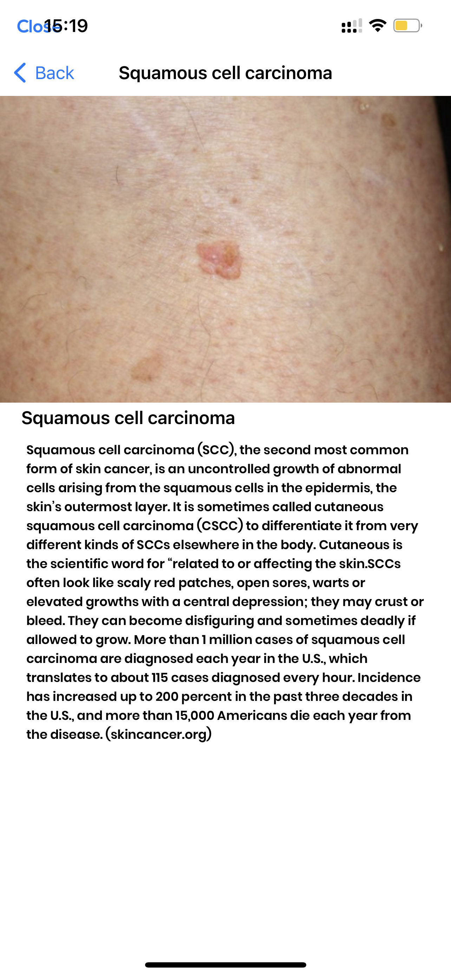
return
scanoma-mole check

Slide 15
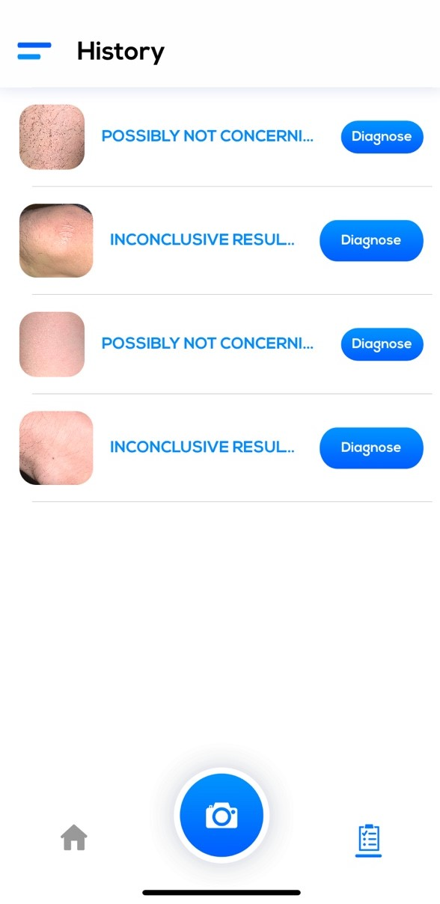
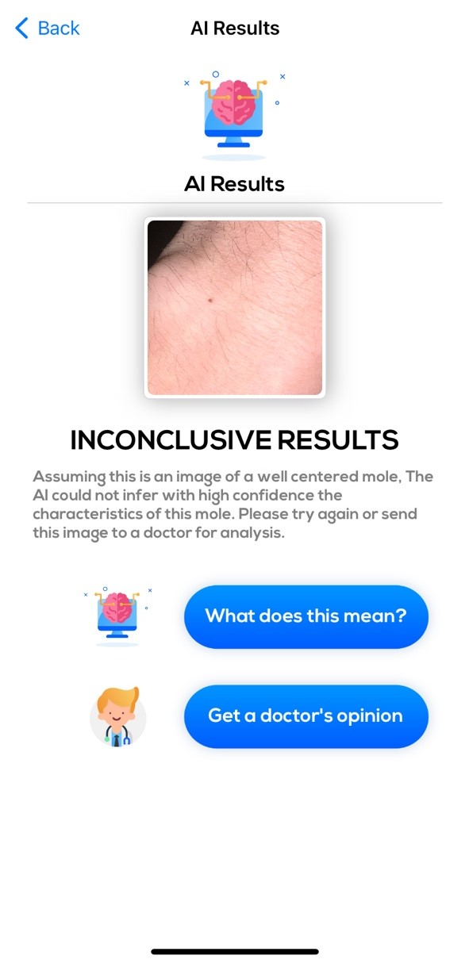
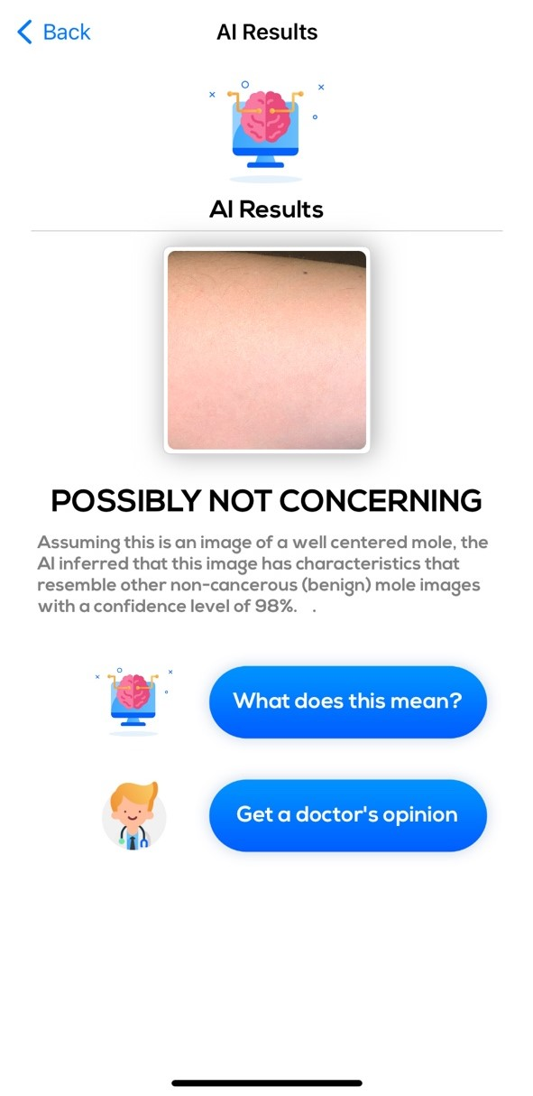
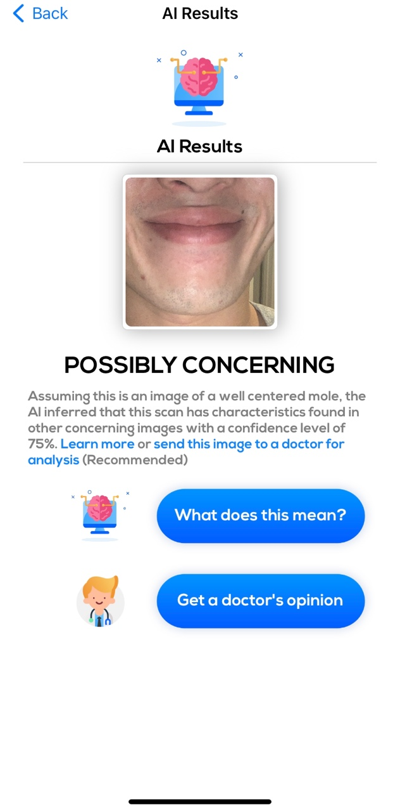
3.scanoma-mole check
return
predictable outcomes

Slide 16
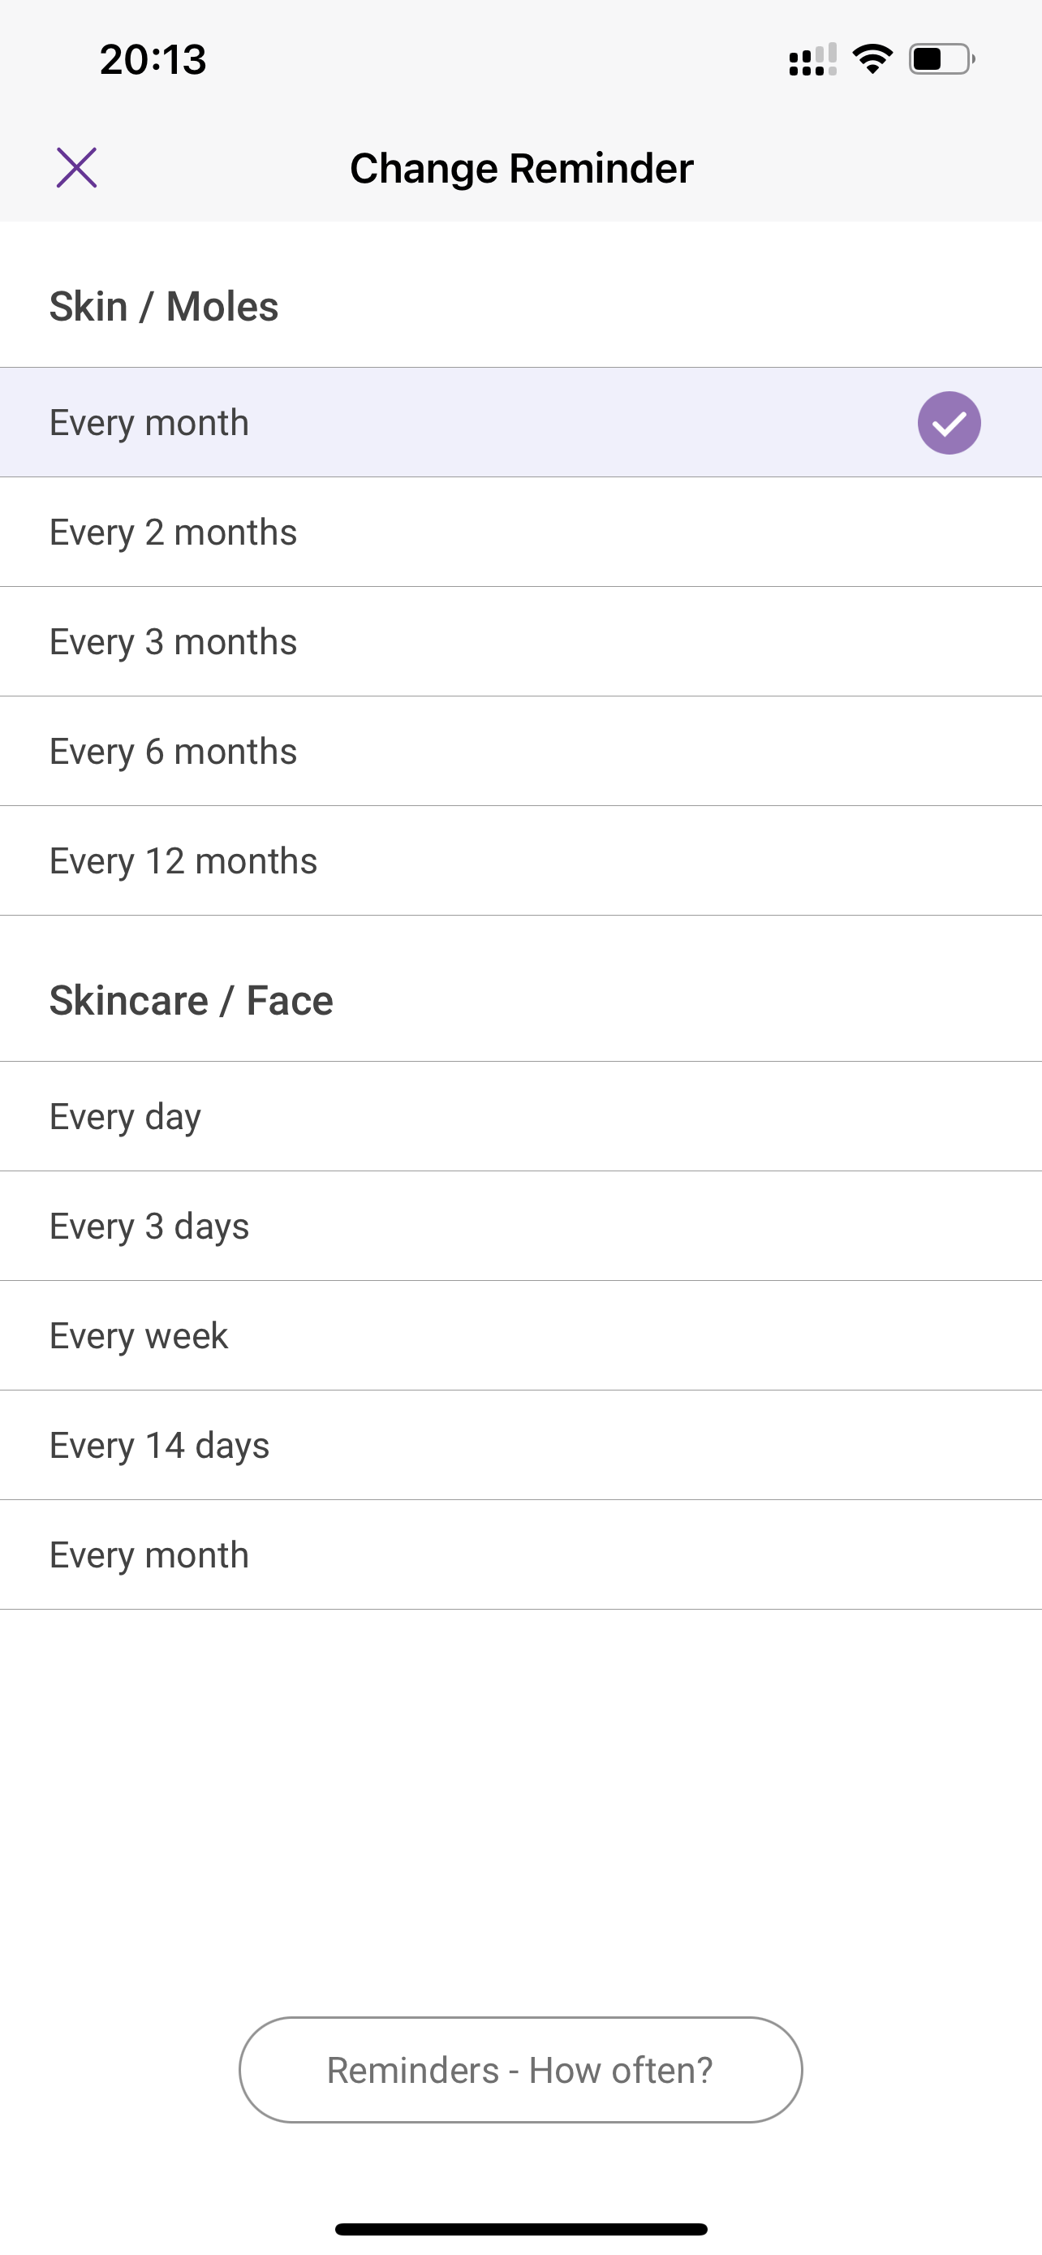
Miiskin
return

Slide 17
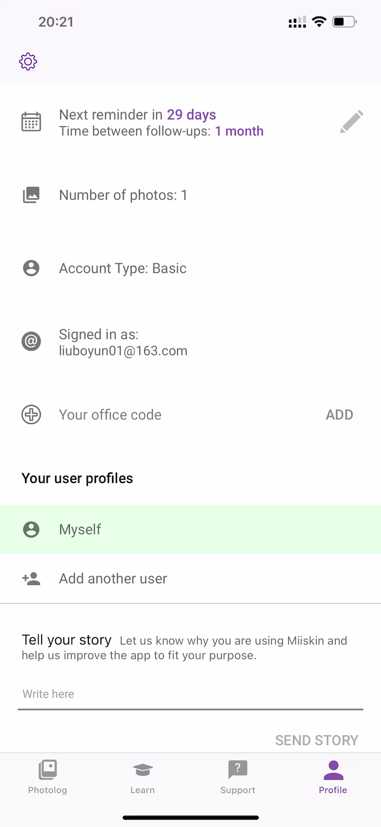
Miiskin
return

Slide 18
Thanks for watching!

